Slide 1
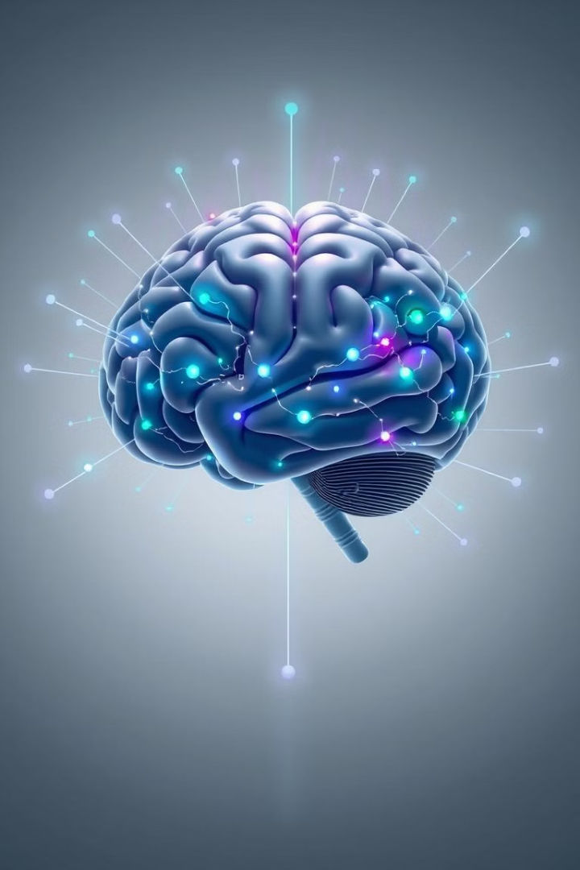
Machine Learning for Cerebrovascular Disorders
This presentation explores the application of machine learning techniques to improve the diagnosis, prognosis, and treatment of cerebrovascular disorders.

Slide 2
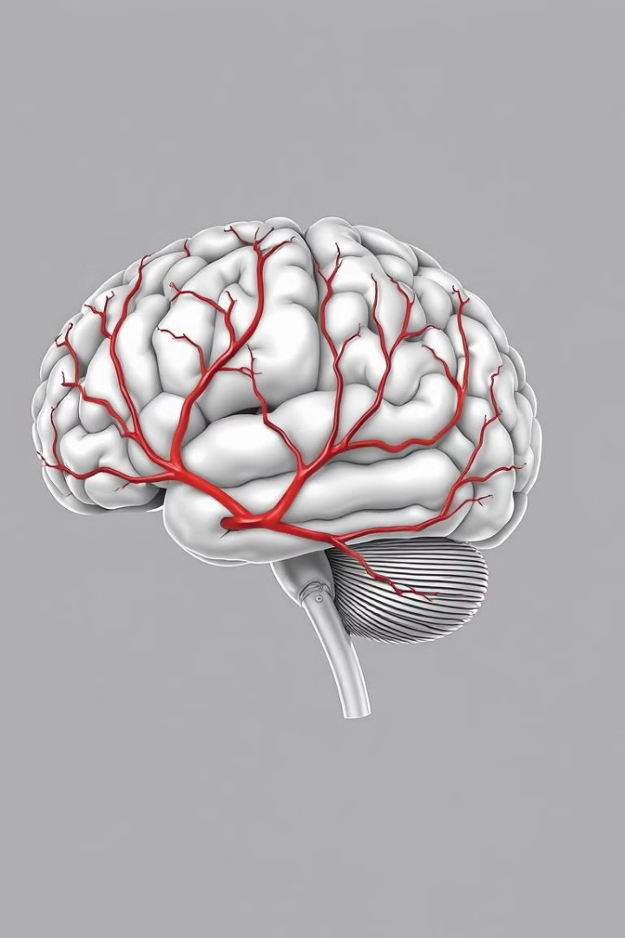
Introduction to Cerebrovascular Disorders
1
Cerebrovascular Diseases
2
Stroke
A medical emergency caused by a disruption of blood flow to the brain, leading to cell death.
Conditions affecting blood vessels in the brain, including stroke, aneurysm, and vascular dementia.
3
Aneurysm
A ballooning or weakening of a blood vessel wall, which can rupture and cause bleeding.

Slide 3
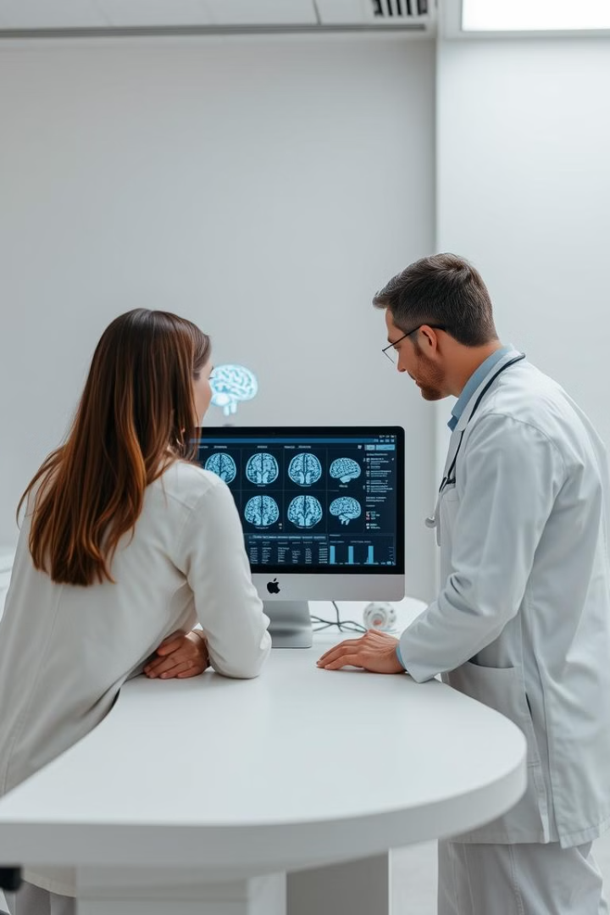
The Role of Machine Learning in Diagnosis and Prognosis
1
Early Detection
ML algorithms can analyze imaging data to identify subtle signs of disease before symptoms develop.
2
Risk Assessment
Predictive models can assess an individual's likelihood of developing a cerebrovascular disorder.
3
Treatment Optimization
ML can help tailor treatment plans based on patient characteristics and disease progression.

Slide 4
Predictive Modeling for Stroke Risk Assessment
Risk Factors
Predictive Models
Clinical Applications
Age
Machine learning algorithms can predict stroke risk based on patient demographics, medical history, and lifestyle factors.
These models can help identify high-risk individuals and guide preventive measures.
Hypertension
Diabetes
Smoking

Slide 5
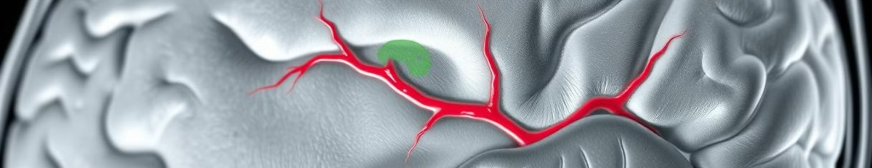
Computer Vision Techniques for Vessel Segmentation
Image Segmentation
Vessel Analysis
Early Detection
Computer vision algorithms are used to identify and segment blood vessels from brain imaging data.
Segmented vessels are analyzed to measure size, shape, and flow patterns.
Abnormal vessel characteristics can indicate early signs of cerebrovascular disease.

Slide 6




Natural Language Processing for Extracting Insights from Medical Records
Medical Records
Electronic health records contain valuable information about patients' medical history and treatments.
NLP Techniques
Natural language processing algorithms can extract relevant data from unstructured text.
Disease Insights
Analyzing patient records can help identify patterns and trends related to cerebrovascular diseases.

Slide 7
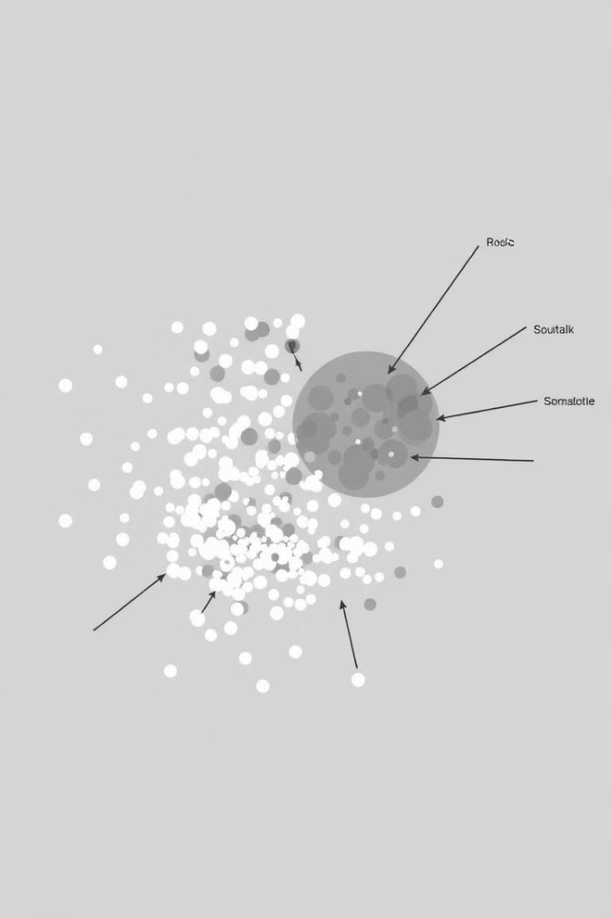
Clustering Algorithms for Identifying Disease Subtypes
Subtype
Characteristics
Ischemic Stroke
Blood clot blocks artery
Hemorrhagic Stroke
Blood vessel ruptures and bleeds
Transient Ischemic Attack (TIA)
Temporary blockage, symptoms resolve quickly

Slide 8
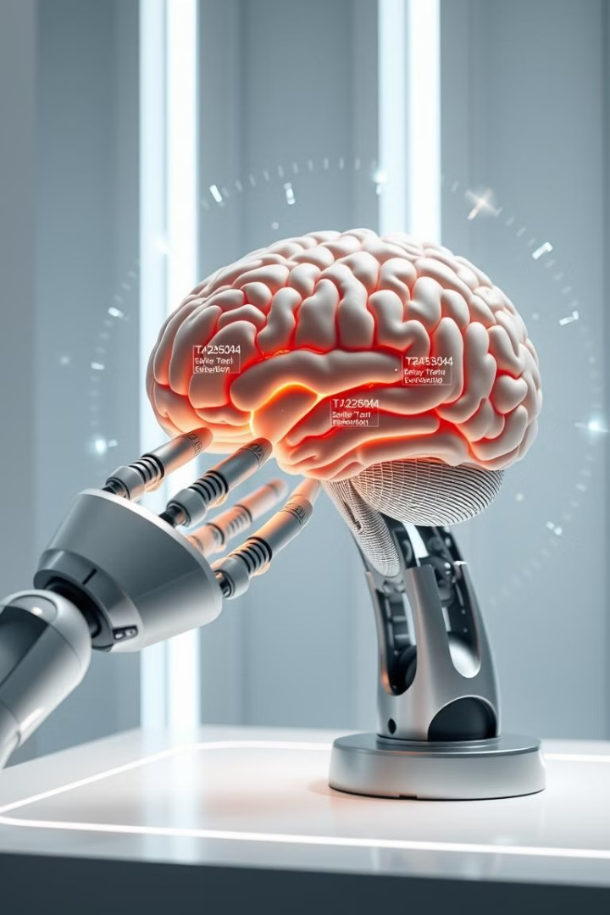



Reinforcement Learning for Optimizing Treatment Strategies
Personalized Treatment
RL algorithms learn from trial and error to tailor treatment plans to individual patients.
Optimal Outcomes
RL aims to find the most effective treatment strategies to improve patient recovery.
Adaptive Learning
RL algorithms can adapt to changes in patient conditions and treatment responses.

Slide 9
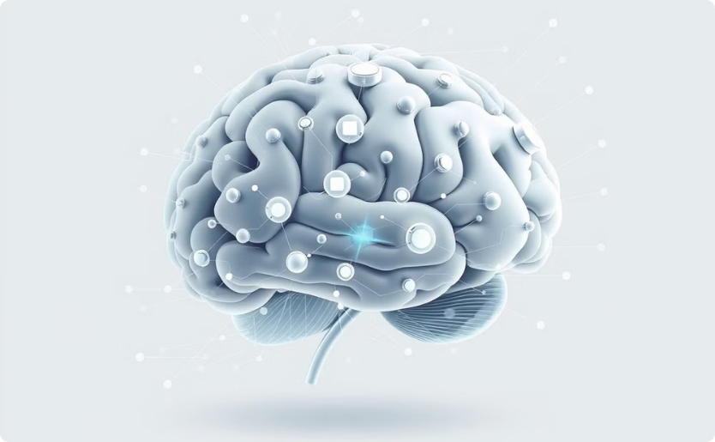
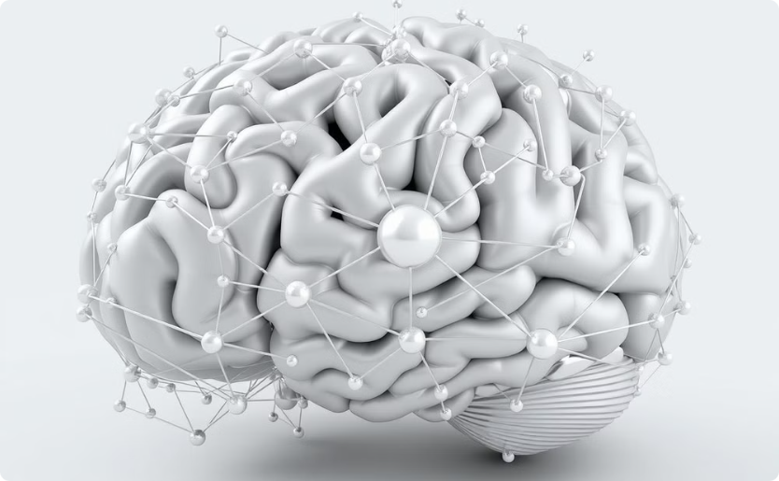
Future Directions and Emerging Trends
Brain-Computer Interfaces
Artificial Neural Networks
BCIs have the potential to revolutionize stroke rehabilitation and provide real-time brain monitoring.
Deep learning models can analyze vast datasets to identify subtle patterns and relationships.

